Slide 1

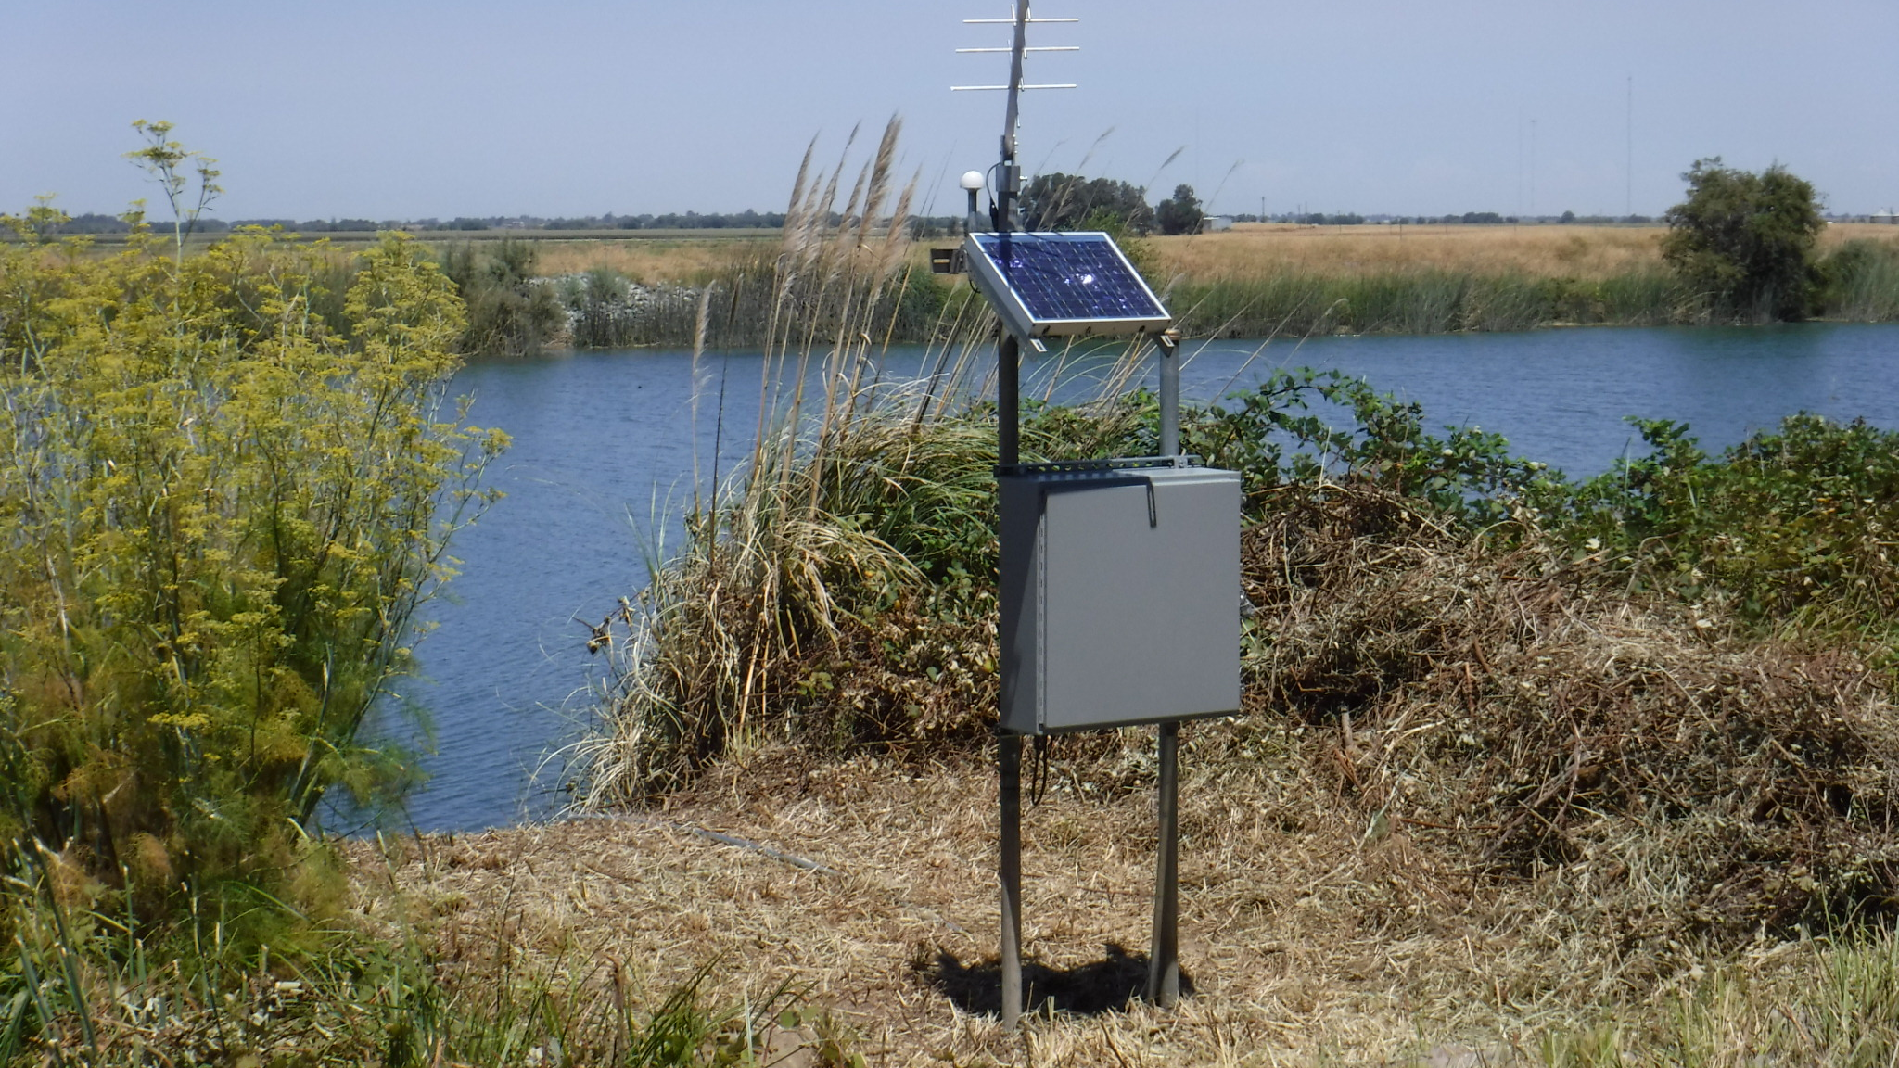
SB 19 Stream Gaging Overview and Tool Development Framework
UC Berkeley and Internet of Water
June 2021

Slide 2


General Comments
Overview slides are pulled from the June 2021 TAC meeting.
Intent is to communicate with UCB and IoW on development of a prioritization framework and vision for data visualization and potential tools to outlive report version of project.
In addition, there are discussion slides not meant for presentation, but rather to frame an internal discussion. This is a living document.
Some slides are repeats in the sections
Notes:
These extra-wordy slides should not be presented! This may migrate to a document later.

Slide 3
Personnel (likely involved directly)
Internet of Water – Kyle Onda, Lauren Patterson (Peter Colohan)
UC Berkeley – Lucy Andrews (Ted Grantham)
Tech Team – Valerie Zimmer (SWRCB)
- Todd Carlin – ecosystem and GIS (CDFW)
- Keenan Smith – gage inventory and GIS (SWRCB)
- others as necessary
Steering Committee – Dan Schultz (SWRCB)
- Teresa Conner (DWR)
and a whole bunch of other people…
Notes:
Expiration date on personnel availability

Slide 4
Project Overview: Prioritization Criteria and Ranking
Beneficial Use Criteria
Ecosystem
Water Supply
Water Quality
Flood Management
Other Criteria in Bill Text
Modernizing, Reactivating, Deploying
Cost-share
Integration in network
AB 1755 and accessible “promptly”
Historic data record
Temperature
Cannabis
Groundwater management
Who is funding the gage?
3. Prioritization Ranking
Beneficial Use Criteria
Multiple Benefits
Conflicts in water management
Reference Gages
Target locations for new gages
2. Prioritization Criteria
Data to be input into a ranking
MANAGEMENT OBJECTIVES
Bill Text “water management and conservation of freshwater species”
Notes:
This is a 2-part question: which data are we using and how are we going to use it?
We are still gathering and assessing resources AND developing spatial representations
Ranking: how to assign values to data, how to combine the data; binning data (reserve some for unimpaired/pristine/reference, and others for high-value)
Issues where, exactly, to gage may be part of implementation … e.g. reactivate.
Scenarios may be run to show the current coverage of existing gages.

Slide 5
Selecting Prioritization Criteria
Preferred: Pre-existing data compilations and indices
Preferred: Vetted by multiple agencies or organizations
Transparent, open, available
Individual Datasets for specialized criteria
Specific locations (e.g. monitoring, reference sites, surface water diversion, etc.)
Notes:
Highlights are HWP areas

Slide 6
Legislative Report (Primary Output Product)
What: Stream Gaging PLAN to legislature (no funding, no installation, primarily to support future efforts)
When: Due 6/30/2022, draft summer 2021
Prioritization Component
List of Priority Watersheds based on Criteria in the Bill
Gage Gap Analysis
Identification of “Low-Hanging Fruit”
Things to Note:
High-level, low resolution (HUC10) analysis – the criteria will be discussed and ranked, but the list will be essentially static.
Narrative recommendations will be included.
Senate Bill No. 19 (SB 19) (Statutes of 2019, Chapter 361, Dodd) enacts Water Code section 144, which directs the Department of Water Resources (DWR) and the State Water Resources Control Board (State Water Board) to develop a plan to address gaging information gaps through the deployment of a network of prioritized stream gages in consultation with the California Department of Fish and Wildlife (CDFW), Department of Conservation (DOC), the Central Valley Flood Protection Board (Flood Board), and interested stakeholders. The stream gaging plan will identify significant gaps in the stream gaging network to meet the wide variety of water management needs, which are increasingly important in the face of a changing climate.
Notes:
We are not doing a comprehensive gage inventory, building a database, etc.

Slide 7
SB 19 Stream Gaging Data Viz and Decision Tool Collaboration, Vision, and Actions
UC Berkeley and Internet of Water
June 2021

Slide 8
Open Questions (for both UCB and IoW)
Should we develop this conceptual model / framework for both, or separate (if both – should we invite Lucy Andrews to the IoW Github repository)
Is there potential for IoW to implement part of the UCB R-code on the backend?
Timelines, Schedules, Workflow.
How will transition to CA-State potentially work? Is there follow-up work? (data-based but also publication-based).

Slide 9
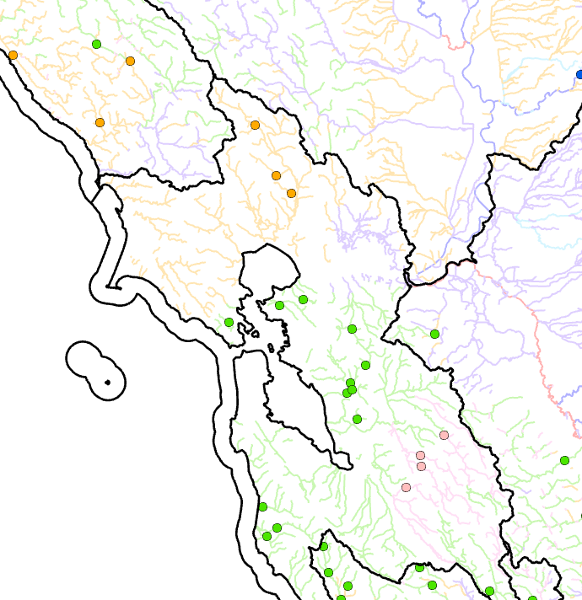

Data Visualization and Decision Tool (Secondary Output Products)
What: Data Visualization, Decision Tool, Data Layers, and Gage Gap
When: As time and resources allow
What would we like to do?
Interactive Visualization of Prioritization and Gage Gap
Ability to identify priorities (where should we put a gage?) based on specific criteria-of-interest or location.
Ability to give credit for proposed locations (what else does this proposed gage benefit?)
Things to Note:
Higher resolution (stream segment level)
Dynamic prioritization
https://internetofwater.org/

Slide 10
Internet of Water – Prioritization Ideas (VZ)
Data Visualization: Visualize input datasets for each of the major criteria
Integrate Gage Gap and Prioritization Analyze into Data Viz: Port UC Berkeley code and/or results and composite scores?
Decision Support: Give user the ability to turn on/off or possibly adjust scores
(prioritization) Data Management
Hosting input data layers -> do we need to publish feature layers?
Native locations and how to automatically retrieve or update
Long-term requirement for maintenance of the site (transfer to SWRCB or DWR?)
Display current gage inventory (QA/QC’d)
discuss feasibility of displaying gages based on outside databases (CDEC/USGS) -> note: this is much harder than it seems.
Tool outlives project and report: hosted at data.ca.gov and updated
I may be suffering from a lack of imagination with Data Viz!

Slide 11
Internet of Water – Steering Committee Ideas (doc review)
“Strengthen the Management of Stream Sensor Data”
Publishing stream sensor metadata
Linking stream sensor metadata to hydrographic data
Process for stream-reach sensor prioritization
Documentation
These are higher priorities for the steering committee than I realized - VZ

Slide 12

Gage Data
Metadata flows
Time series data flows
CA Open Data Portal
Other layers necessary for analysis
NOAA
Human-supervised-semiautomated process
CSWRCB/SB19 ESRI Feature Services
NWIS
Dan + CO
Deduplicates gages, storing by priority:
NWIS/NOAA
CDEC but not NWIS/NOAA
Not in NWIS/NOAA or CDEC (yet)
Adds NHDPlusV2 hydrologic address (why not HR? because HR is a moving target right now, and the NLDI is based on NHDPlusV2)
SB19 Linked Data Server
CDEC
Geoconnex
NLDI
Other local/private/random providers
R instance/ Stream planning tool
Initial Conceptual Model IoW/SB19
Notes:
THIS IS THE INITIAL CONCEPTUAL MODEL. Val – I was not involved with these discussions!

Slide 13
Gage Data
Metadata flows
Time series data flows
CA Open Data Portal
Other layers necessary for analysis
NOAA
Human-supervised-semiautomated process
CSWRCB/SB19 ESRI Feature Services
NWIS
Dan + CO
Deduplicates gages, storing by priority:
NWIS/NOAA
CDEC but not NWIS/NOAA
Not in NWIS/NOAA or CDEC (yet)
Adds NHDPlusV2 hydrologic address (why not HR? because HR is a moving target right now, and the NLDI is based on NHDPlusV2)
SB19 Linked Data Server
CDEC
This is complex due to QA-QC, which includes removing redundant gages, removing canals, and snapping gage locations to stream segments (e.g. changing their locations). Discuss.
Geoconnex
NLDI
We are limiting gages for SB19 gage gap to the “Gold Standard”, but can we develop framework that allows future integration?
COMID????
R instance/ Stream planning tool
Notes:
Some comments – for discussion.
Time and resource constraint limit us to a static list and the gold standard, but can we develop a framework where this is easily replaced with some new data layer addresses and development of automatic screening code (in R?).

Slide 14
IoW Action Items
Publishing stream sensor metadata
Managing the intake from different sources and automating the QA/QC may be a priority under this objective
Publishing stream gage metadata – needs discussion: attributes, locations, etc. Can we get this from the automatic input already (even if we don’t have curated final list?)
How does this different from existing CDEC products? Do we need to add a CDEC person to the Tech Team?
Linking stream sensor metadata to hydrographic data
snap to stream segments, visually inspect questionable gage locations. Do we keep canals, etc.?
Process for stream-reach sensor prioritization
This is the current focus of the Tech Team and UCB SNAG collaboration
Documentation
SB19 plan draft is due in Sept; potential for additional publications
Notes:
May need to get Keenan involved to help backanalyze the QA-QC so that an automate process PLUS a list of decisions can be generated. May need to add a CDEC person to the team?

Slide 15
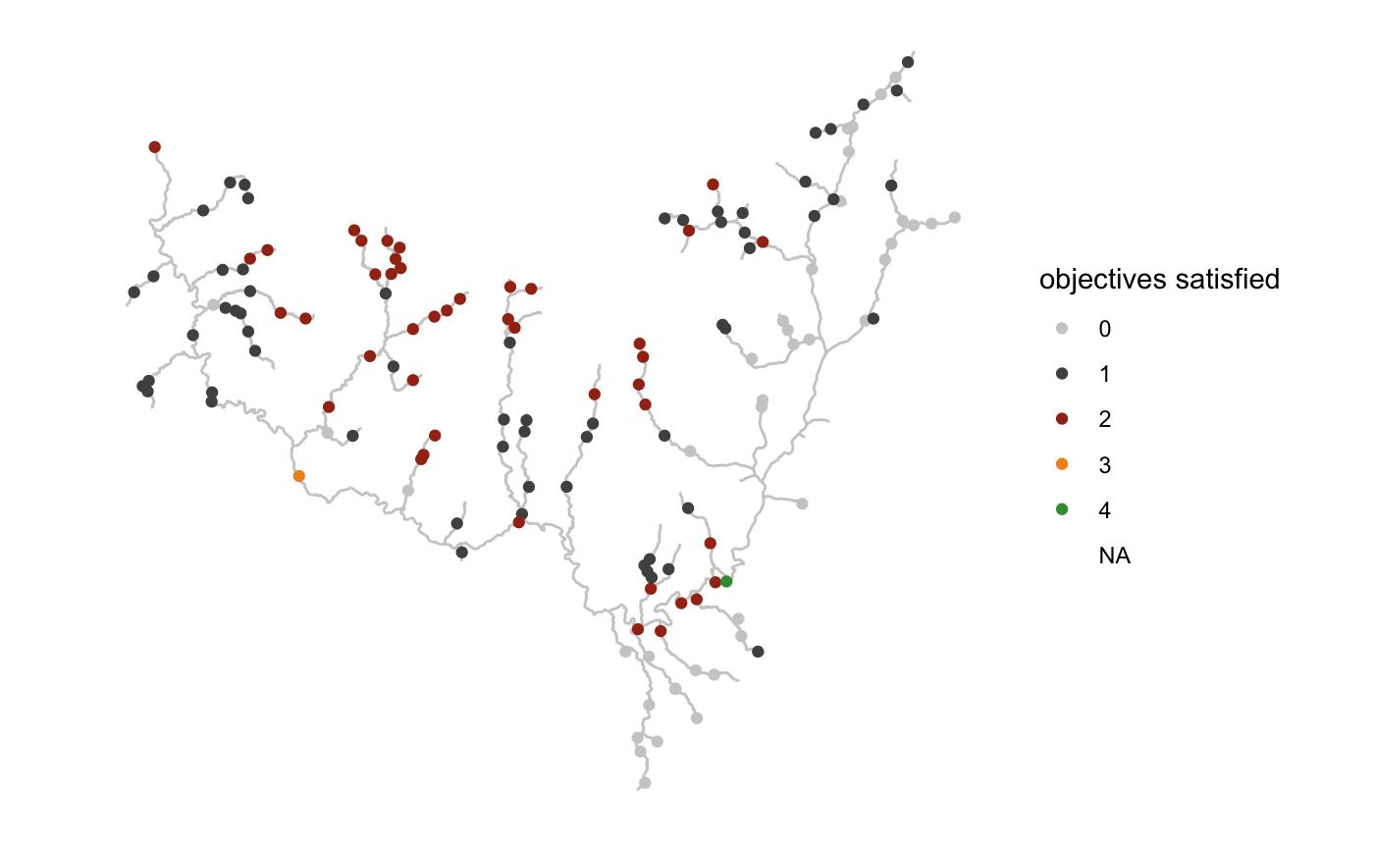
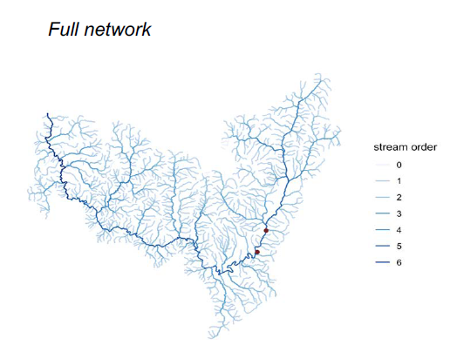
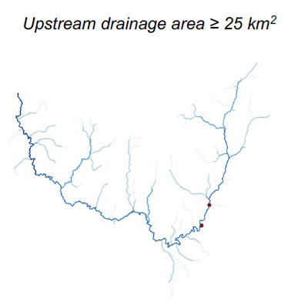
Collaboration with UC Berkeley: Applying SNAG to SB19 effort
Gage Gap is based on gage location and watershed area (similar to TNC Gage Gap II*)
Developing code to integrate with:
Ecosystem layers (HUC12) -> single metric
Reference gage effort
TBD: other layer types
Questions:
How to scale up (summarize) stream-segment-level data for reporting?
How to eliminate stream segments that are hydrologically unsuitable for gage prioritization?
Can we integrate with data visualization effort?
Source: Grantham, T. and Andrews, L., 2020, Stream Network Analysis for Gages, UC Berkeley 22 Oct 2020
* The Nature Conservancy Gage Gap 2019 www.codefornature.og

Slide 16
UCB Berkeley SNAG Tool: What we hope to Accomplish
Resolve issues with stream segment (suitability) and gage datasets
Resolve issues with scaling and normalization (if exist)
Develop tool with adjustable weighting on input datasets, and generate a composite score for each of the major management criteria
Analyze multi-criteria benefits (internal - not for publication – avoid pitting one criteria vs. another)
Develop HUC10(?) level results from stream segment level of resolution in tool?
Separate gage gap results from criteria results, allowing the tool to run gage gap once and prioritization many times? (computational time decrease?)
Analyze the current network to determine how well it is currently meeting each of the priority areas?
Loaded question with many definitions needed?
Would be nice to determine if the current network is serving one criteria well and other poorly (or not)
Notes:
LIVING DOCUMENT – we can move elsewhere as well.

Slide 17
Stream Segment Selection Concerns
Perennial vs Intermittent vs. Ephemeral (do we ignore ephemeral streams?) we do not have enough data to support this in NHDPlus v2, but we may be able to apply criteria from eFlows and require selecting higher order streams, or add a narrative recommendation.
Stream order or Drainage Area (NHDPlus v2 VAA) threshold to ignore?
Other suitability criteria do we eliminate non-natural sites? note – the data may not support this as some major rivers have been moved and are thus coded as artificial.
Multi-benefits may be a function of resolution: e.g. there may be multiple needs within a HUC12, but it may be impossible to select a site to cover all benefits if they occur in different parts of the watershed.
Scale: stream segment vs. HUC – how to change scale for purposes of a high-level report? For identifying priorities?
Notes:
Is “Managing for Multiple Benefits” inherently at odds with “Ecosystem” Priorities?
Are some of the input criteria correlated, and if so, should we change the relative weighting?
Are ephemeral streams in the scope of a stream gaging plan if that are dry and flashy, or is that a different monitoring effort?

Slide 18
Stream Segment Questions
NHDPlus V2 has 180,000+ stream segments
CA eFLows uses ~70,000 stream segments (appears to have eliminated some canals and small stream segments)
What were their exact methods?
NHDPlus V2 – filtering on Fcode for just … -> inadvertently eliminates some major rivers and the Yolo Bypass because the current paths are “artificial”… difficult to automate?
Not enough resolution to filter out ephemeral streams (too many intermittent)
NHDPlus V2 – can be filtered on Stream Order (delete <= 2?) or Total Drainage Area (< ???)
This may eliminate many canals by itself??
NOTE: it is important to import all California stream segments, including those in HUC 15, 16, 17

Slide 19
Scaling and Data Resolution Questions
How to scale from stream segment to HUC 10 level (average or median value? Maximum value)
How to avoid inadvertently penalizing high resolution datasets
How to conduct multi-criteria analysis when the different criteria exist in the same watershed but not in the same location (e.g. it would be impossible for one gage to cover both, but the prioritization may show both criteria as being “present” and therefore prioritize this location as a place where a single gage could be multi-purpose)

Slide 20
SB 19 Stream Gaging Gage Inventory and Gage Gap
UC Berkeley and Internet of Water
June 2021

Slide 21
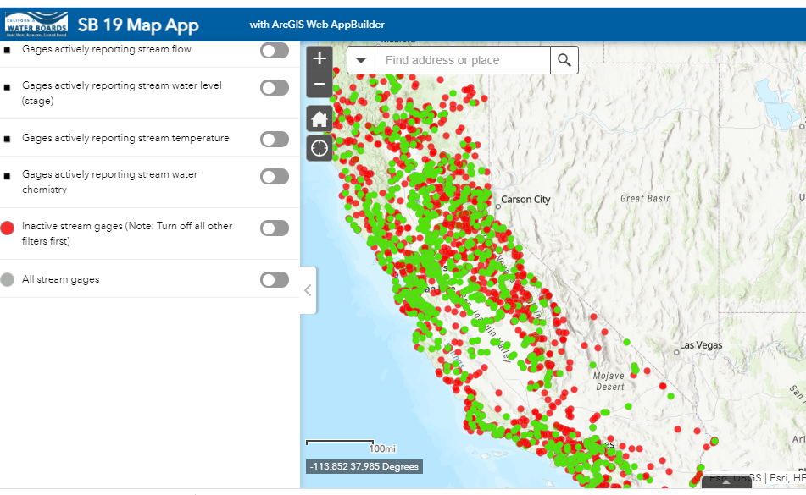
Gage Inventory – Scope based on Timeline / Resources
How will we use Gage Inventory?
Gage Gap Analysis: Gold Standard Gages only
Validation: All gages (Gold, Gray, and Other) will be used to confirm that Prioritization is correctly identifying high interest areas.
Implementation: recommendation(s) for re-activating old sites, upgrading existing sites, etc.
Outreach Messaging: we will not be using gage location data in the gage gap analysis unless/until we confirm they meet the gold standard, nor compiling a comprehensive inventory, nor developing a database of gages and gage data.
We will use all available gage information for validation and implementation.
Data Collection
USGS, CDEC, and other public databases
All public communications & data input form
Removal of redundant, powerplant, canal, etc.
Notes:
GAGE INVENTORY – HARDER THAN IT SOUNDS

Slide 22
Gage Inventory Complications!
We need to backanalyze QA – QC in order to automate gage intake and QA-QC. Most of this work was done in GIS
Need to remove redundant gages from USGS/CDEC and other sources. This is not automatable –gages have different names, plot in different locations, and often require individual inspection. (Generate a known list of redundant gages?)
Need to remove gages that are not on natural channels (round 1 – based on name or metadata?)
Need to differentiate Inactive and gages that do not record flow (stage-only, etc.)
Need to snap gages to stream segment AND manually review that snap (generate a know list) and then remove gages on non-natural channels (round 2?)
New data will have to be flagged, manually reviewed, and added to the “fix” lists.

Slide 23
Gage Inventory: What do we want to know? This could be the framework for metadata?
Why? Primary management objectives for gage and criteria applied for site selection
What? Stage, flow (rating), water quality, other data collection at the site?
Seasonality and Flow Range seasonal or year-round? Rating flow range?
Length of Record How long has gage been in operation?
Rating and Maintenance? How often/ when are flow measurements made; other QA/QC re: maintenance
Location watershed, stream segment, any unusual information about site or waterbody
Contact who operated? Where is data located? API? Telemetered? Publicly available?
Permanence is funding stable? Potential for collaboration or co-funding?
Notes:
This slide needs work
Green text – additional objectives in bill text (for prioritization or implementation considerations)
Blue text – methodology validation
Red text – prioritization

Slide 24
Collaboration with UC Berkeley: Applying SNAG to SB19 effort
Gage Gap is based on gage location and watershed area (similar to TNC Gage Gap II*)
Developing code to integrate with:
Ecosystem layers (HUC12) -> single metric
Reference gage effort
TBD: other layer types
Questions:
How to scale up (summarize) stream-segment-level data for reporting?
How to eliminate stream segments that are hydrologically unsuitable for gage prioritization?
Can we integrate with data visualization effort?
Source: Grantham, T. and Andrews, L., 2020, Stream Network Analysis for Gages, UC Berkeley 22 Oct 2020
* The Nature Conservancy Gage Gap 2019 www.codefornature.og

Slide 25
UCB Berkeley SNAG Tool: What we hope to Accomplish
Resolve issues with stream segment (suitability) and gage datasets
Resolve issues with scaling and normalization (if exist)
Develop tool with adjustable weighting on input datasets, and generate a composite score for each of the major management criteria
Analyze multi-criteria benefits (internal - not for publication – avoid pitting one criteria vs. another)
Develop HUC10(?) level results from stream segment level of resolution in tool?
Separate gage gap results from criteria results, allowing the tool to run gage gap once and prioritization many times? (computational time decrease?)
Analyze the current network to determine how well it is currently meeting each of the priority areas?
Loaded question with many definitions needed?
Would be nice to determine if the current network is serving one criteria well and other poorly (or not)
Notes:
LIVING DOCUMENT – we can move elsewhere as well.

Slide 26
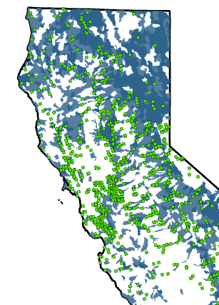
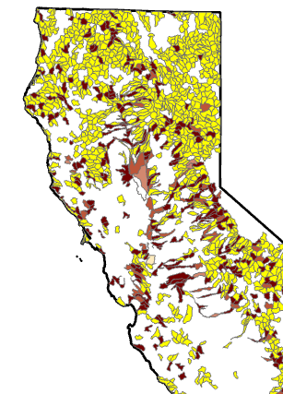
Additional Possible Application of “Gage Gap” Tool Example: How well does current gage network cover a specific management objective?
Why this might be important
Is current gage network skewed toward some priorities and not others?
Does this change ranking or implementation?
Identifying high-priority areas for new gages does not inherently require that we assess this for each of the criteria.
Current scope may not allow time for this assessment directly, but it could be something that a tool could help answer for future work.
A
B
A – HUC12 with GDE and gages; B – HUC12 with GDEs and at least one gage (red) and no gages (yellow).
Groundwater Dependent Ecosystem (GDE)
77% of subwatersheds with medium or high value GDEs do not have a gage. Additionally, 90% of subwatersheds with medium or high value GDEs have either no gages, or only have one gage.
Notes:
There may not be time to assess this for each of the criteria, so it needs to be acknowledged and data provided for later assessment.

Slide 27
SB 19 Stream Gaging Prioritization Framework
UC Berkeley and Internet of Water
June 2021

Slide 28
Basic Strategy for Prioritization
Ecosystem: HUC12 plus limited stream segment data
Water Quality: point location data plus 303d listed segments plus “hot spots” still reviewing datasets; scaling up issues?
Water Supply (incl. Cannabis and Groundwater): combination point data, stream segment data, known gage issues how do we combine all of these different data types?
FloodMAR: gages need to be upstream! Additional complication.
Flood Management: combination of point data (CNRFC list) plus Post-Fire Risk – how to combine data?
Reference Gages: backwards analysis – determine spatial distribution, then prioritize areas with fewest gages. Analyze for suitable locations after prioritization. HUC-eFlows categories / priority list.
Multi-Criteria Benefit: analyze the overlap between the 4 or 5 categories. Internal only.
Additional Criteria: (e.g. tribal, disadvantaged communities, climate, etc. – how does this fit in? Narrative only?)
Narrative: some criteria, such as reference gages, benefit multiple categories. Thus, if it appear that data lacking in a category, it may be covered in another category.
Gage Gap is applied AFTER Prioritization and may eliminate many high priority sites, particularly flood management and water quality. Do we account for this in the scoring?

Slide 29
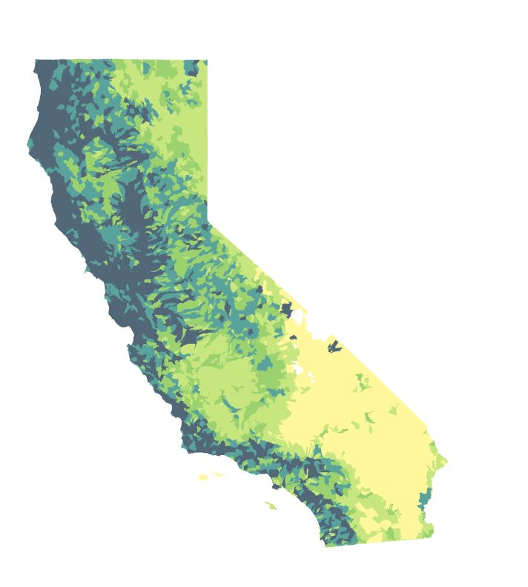
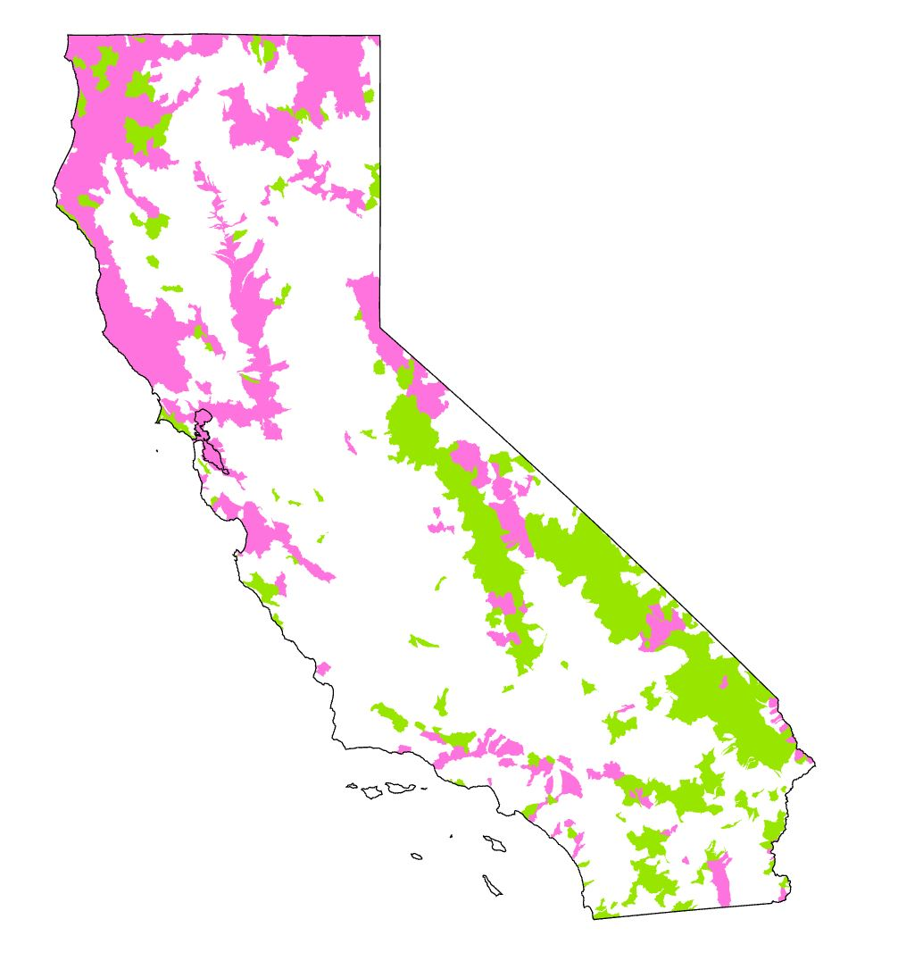
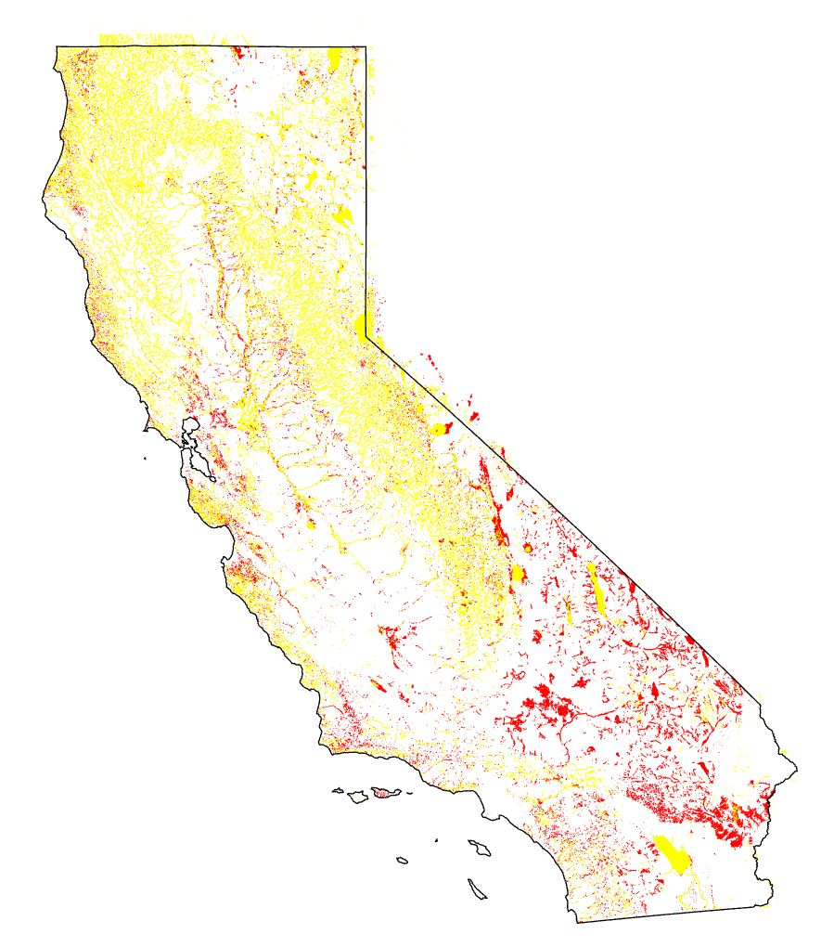
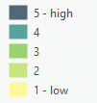
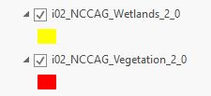
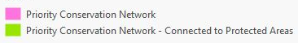
Ecosystem Management Criteria
Preliminary Recommended Selection
Aquatic Biodiversity: CDFW (2018-2020), Areas of Conservation Emphasis (ACE), Aquatic Biodiversity Rank HUC12 resolution
Priority Conservation Network: TNC (2018) California Freshwater Blueprint HUC12 resolution
Groundwater Dependent Ecosystems: TNC (2021), Natural Communities Commonly Associated with Groundwater (NCCAG) v02 independent shapes
ACE aquatic biodiversity rank
TNC CA Freshwater Blueprint
TNC iGDE NCCAGv02
Notes:
Will use ECOSYSTEM

Slide 30
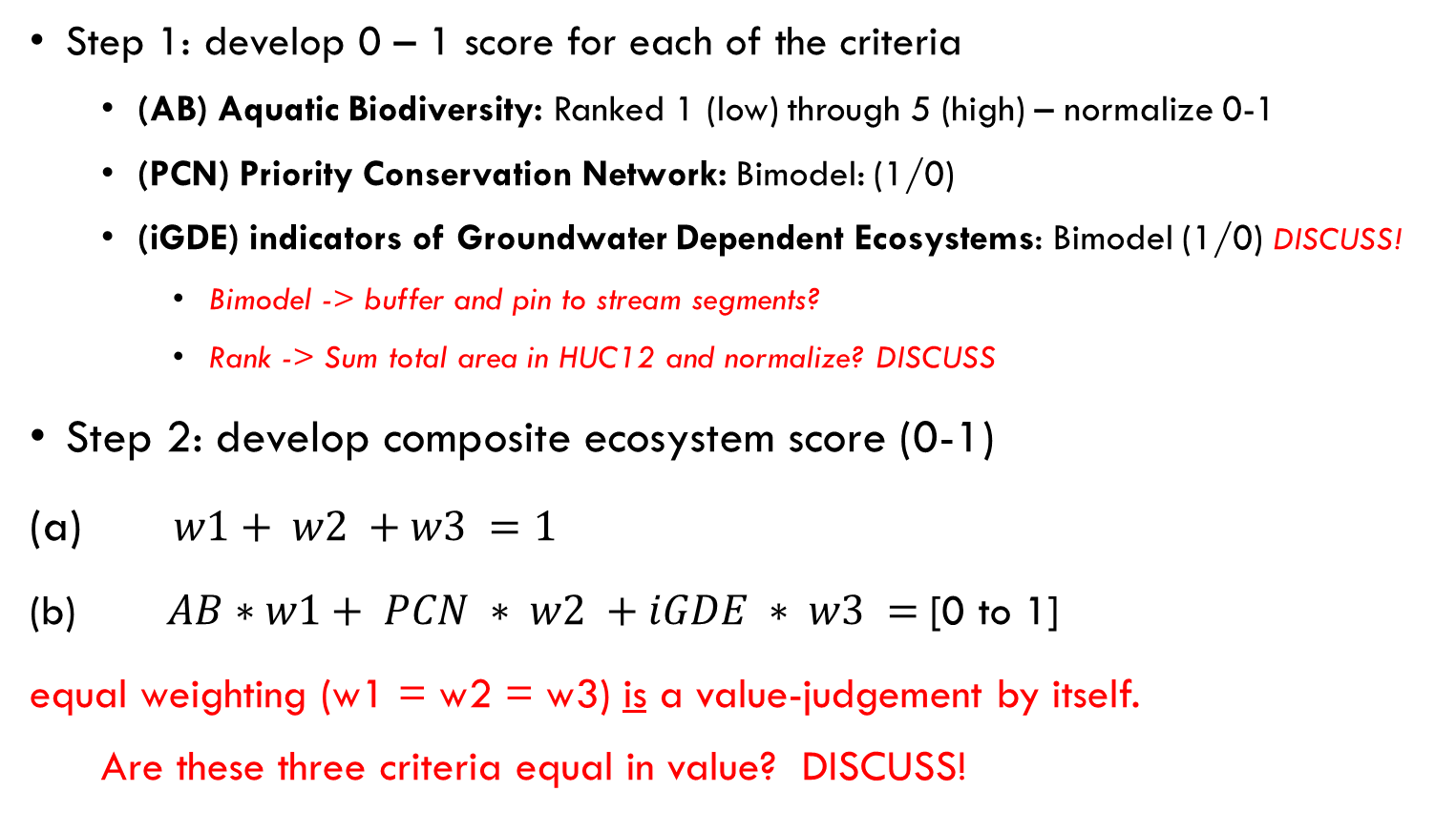
Decision Analysis Example Ecosystem Management (proposed) methodology
Step 1: develop 0 – 1 score for each of the criteria
(AB) Aquatic Biodiversity: Ranked 1 (low) through 5 (high) – normalize 0-1
(PCN) Priority Conservation Network: Bimodel: (1/0)
(iGDE) indicators of Groundwater Dependent Ecosystems: Bimodel (1/0) DISCUSS!
Bimodel -> buffer and pin to stream segments?
Rank -> Sum total area in HUC12 and normalize? DISCUSS
Step 2: develop composite ecosystem score (0-1)
(a) $w1+ w2 +w3 =1$
(b) $AB∗w1+ PCN ∗ w2 +iGDE ∗ w3 =$[0 to 1]
equal weighting (w1 = w2 = w3) is a value-judgement by itself.
Are these three criteria equal in value? DISCUSS!
ACE aquatic biodiversity rank
TNC CA Freshwater Blueprint
TNC iGDE NCCAGv02
Notes:
iGDE – the easiest method is “does the stream segment cross a wetlands Y/N”. Does not consider
do we pin them to stream segments? Rank by total area in HUC12?

Slide 31
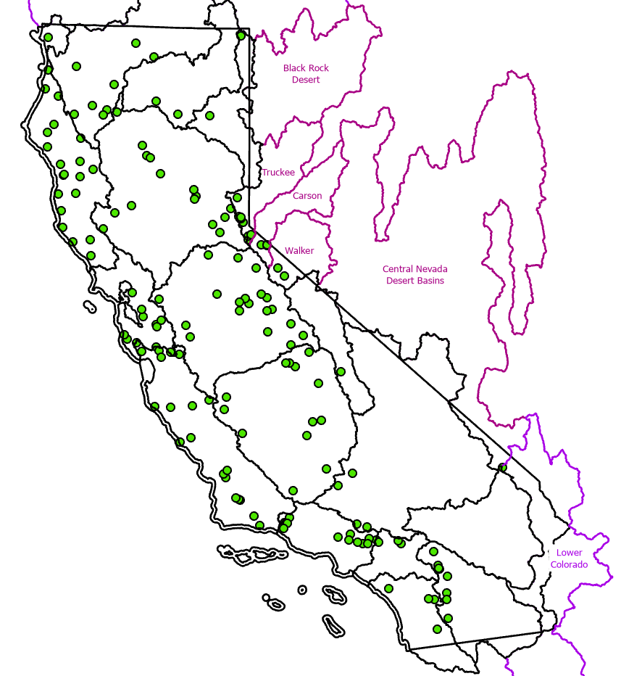
Reference Gages Overview
Definition: Reference-quality gages are those with a low level of anthropogenic impairment which can be used to understand the natural flow response in a given area.
Reference gage watersheds must be relatively unimpaired.
USGS Gages II: evaluated all USGS gages to determine whether they are reference-quality (~25% of all gages) based on land use, water use, agriculture, timber, dam, and other influences
SB19: specifically requires prioritization of reference sites.
Reference gages need to be well-distributed spatially.
Reference gages support water supply and flood modeling, county planning, forecasting, and other important water-related needs.
Gages-II reference
Falcone, J.A., 2017, U.S. Geological Survey GAGES-II time series data from consistent sources of land use, water use, agriculture, timber activities, dam removals, and other historical anthropogenic influences: U.S. Geological Survey data release, https://doi.org/10.5066/F7HQ3XS4.
Notes:
SWAMP reference location Lori Webber
Streamstats have identified reference-quality gages that are currently inactive.
***Reference quality: 20+ yrs, impaired, <5% imperviousness, no dams/canals, ???
USGS Gages II IDs reference quality status – excel database, on sharepoint spreadsheet (Todd)
UCDavis E-flows – did an assessment from reference-quality status
Reference-quality streamgages are those judged to be largely free of human alterations to flow, whereas nonreference quality streamgages may have substantial human alterations to flow (Falcone et al, 2010). All streamgages were screened and categorized as either reference quality or nonreference quality by calculating a hydrologic disturbance index (presence of dams, change in reservoir storage, number of canals, road density, proximity to major pollutant discharge site, estimates of water withdrawals, and fragmentation of undeveloped land), reviewing historical digital maps and imagery for evidence of hydrologic alteration and human activity, and reviewing comments in USGS annual water data reports for information on regulation or diversions. (Kiang et al, 2013)

Slide 32
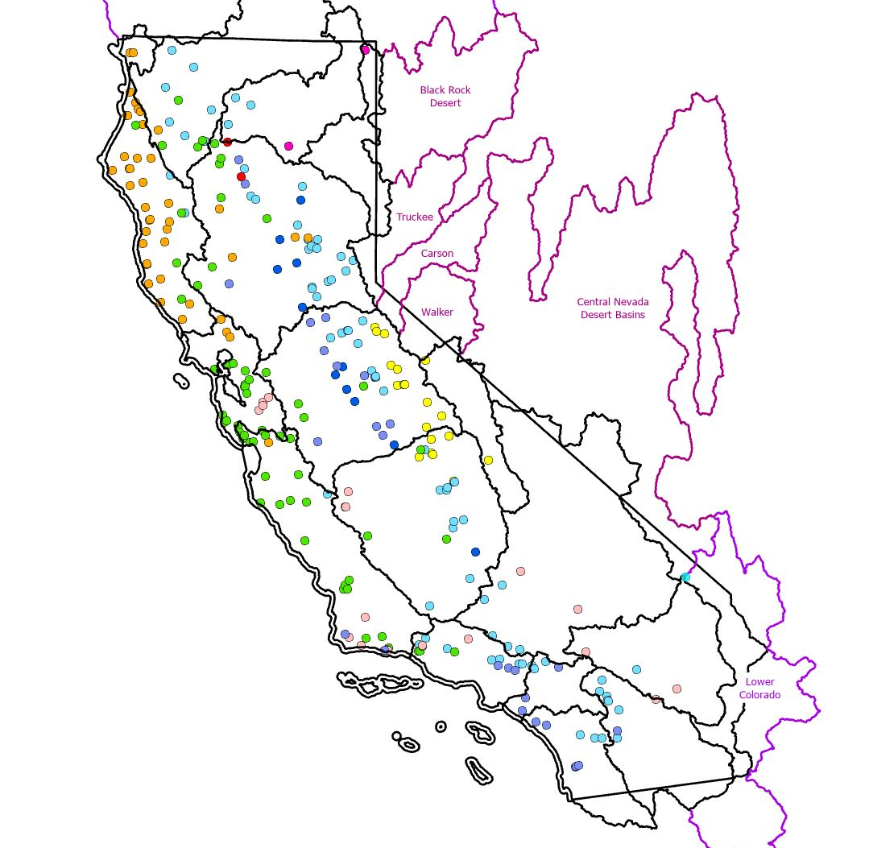
Hydrology Reference Gage Prioritization: SPATIAL Component
Geographic: HUC6
Stream Type: eFlows (9)
Reference Gages: e-flows
Results: 96 HUC-classes total
Note: eFlows ≠ Gages II reference gages (?)
https://eflows.ucdavis.edu/hydrology
eFlows reference
Lane, B.A., Sandoval-Solis, S., Stein, E.D. et al. (2018). Beyond Metrics? The Role of Hydrologic Baseline Archetypes in Environmental Water Management. Environmental Management 62, 678–693. https://link.springer.com/article/10.1007/s00267-018-1077-7
Zimmerman, JKH, Carlisle, DM, May, JT, et al. (2018). Patterns and magnitude of flow alteration in California, USA. Freshwater Biol. 63: 859– 873. https://onlinelibrary.wiley.com/doi/full/10.1111/fwb.13058
Notes:
Problem: there are xx partial HUC 6 that are OR, NV, or AZ watersheds (mostly NV). No CA e-flows available – need to review separately
eFlows reference gages >> Gages II reference gages

Slide 33
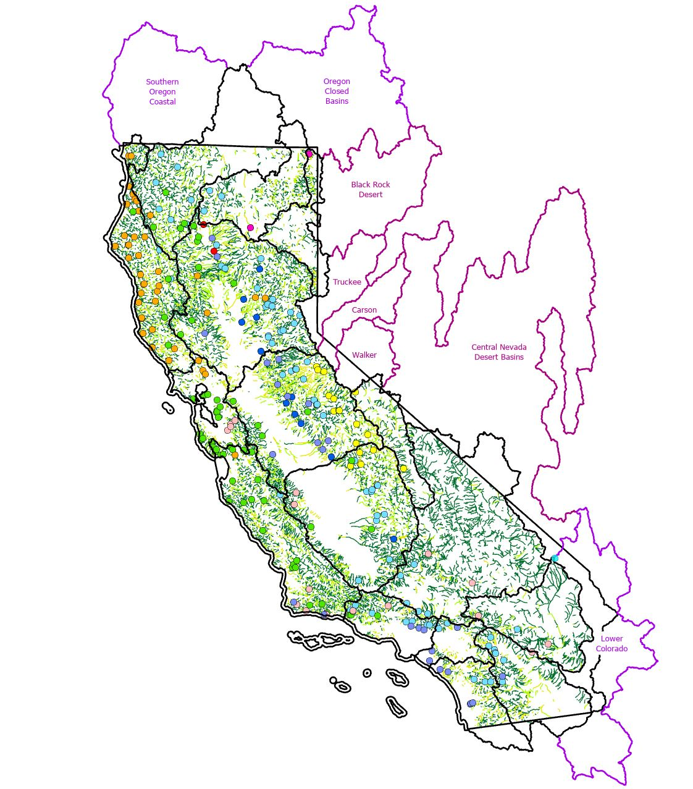
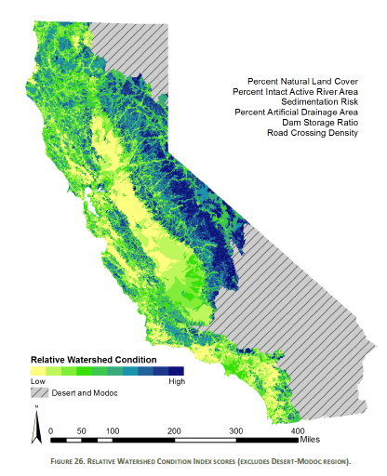
Hydrology Reference Gage Prioritization: SUITABILITY Component

Slide 34
Hydrology Reference Gage Prioritization: Example Results
96 HUC-classes total too few?
Major, minor, and very minor
Remove very minor (e.g. there are no gages for a good reason)
Sort based on gages per stream length, percent of HUC6, or some other similar criteria
Evaluate Suitability!
Is HUC6 too coarse? Drop to HUC10 or HUC8?
Notes:
Problem: there are xx partial HUC 6 that are OR, NV, or AZ watersheds (mostly NV). No CA e-flows available – need to review separately

Slide 35
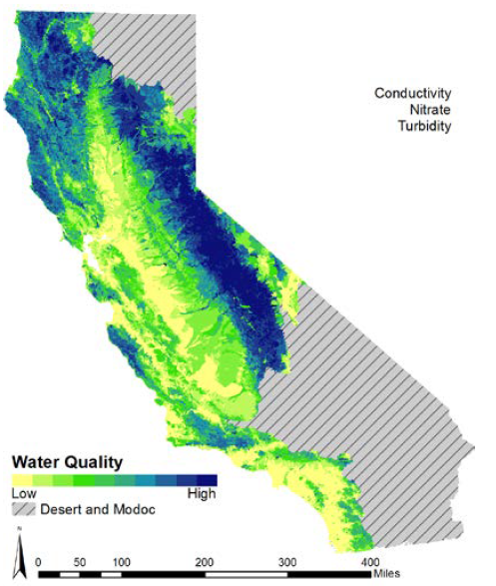
Water Quality Data – Direct Use Challenges
Where should we put a gage?
Do we prioritize the most impaired areas or the most pristine?
US EPA (2013), California Integrated Assessment of Watershed Health, https://mywaterquality.ca.gov/monitoring_council/healthy_watersheds/assessment.html

Slide 36
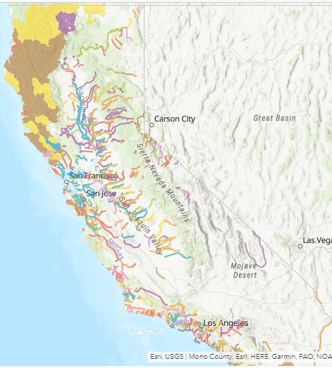
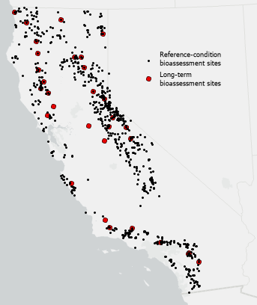
Water Quality Management Criteria
(proposed) Data Selection and Strategy
Water Quality Monitoring locations: as priorities for flow gaging point location (stream segment) resolution
Spatial compilation of site visit frequency / long-term
Highest or reference quality sites?
303d listed streams Bimodel (1/0) stream segment or area resolution
Datasets under review
SWAMP Bioassessment
Temperature monitoring locations
Other SWAMP data?
Pesticide (STORMS)?
CWIP Portal https://indicators.ucdavis.edu/cwip/data/download
Blue-Green Algae?
Identify current issues and hot spots (PFAS and nutrient/phosphates); Simple analysis – difference point locations
Notes:
How to weight different water quality measurements (and their respective data collection frequencies)?
map shows reference-condition bioassessment sites that are part of the California Stream Condition Index (CSCI) monitoring network. The CSCI is a statewide biological scoring tool that translates data about benthic macroinvertebrates (BMIs) found living in a stream into an overall measure of stream health. Variables related to human activity (e.g., land use, road density) were used to classify monitoring sites as reference-condition (i.e., low-activity/least disturbed monitoring sites). The number of reference sites varied by region, with the highest concentrations of reference sites in mountainous regions (e.g., the Sierra Nevada, North Coast, and South Coast Mountains). My understanding (with caution) is that these reference-condition sites serve as a basis against which to assess taxonomic completeness/biological condition at other, non-reference bioassessment sites.

Slide 37
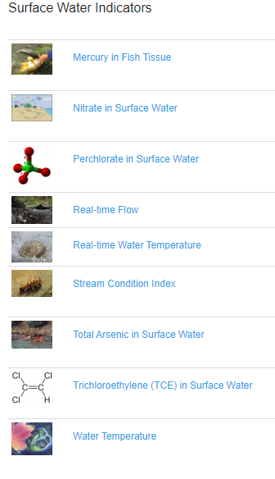
Example: CWIP data
Data are measurements and a “score”.
Prioritize sites with the highest # of measurements
Arsenic, Nitrate, Mercury, TCE, Perchlorate, and Temperature
Analyze each separately?
Summarize?
TAC recommended reviewing PFAS and phosphates
TAC recommended considering hot spots (if we ID them)
California Water Indicators Portal https://indicators.ucdavis.edu/cwip/
Notes:
Problem: are some of these data already being included in our analyses? (example: are we using CSCI elsewhere in the same way?)
How to weight different water quality measurements (and their respective data collection frequencies)?

Slide 38
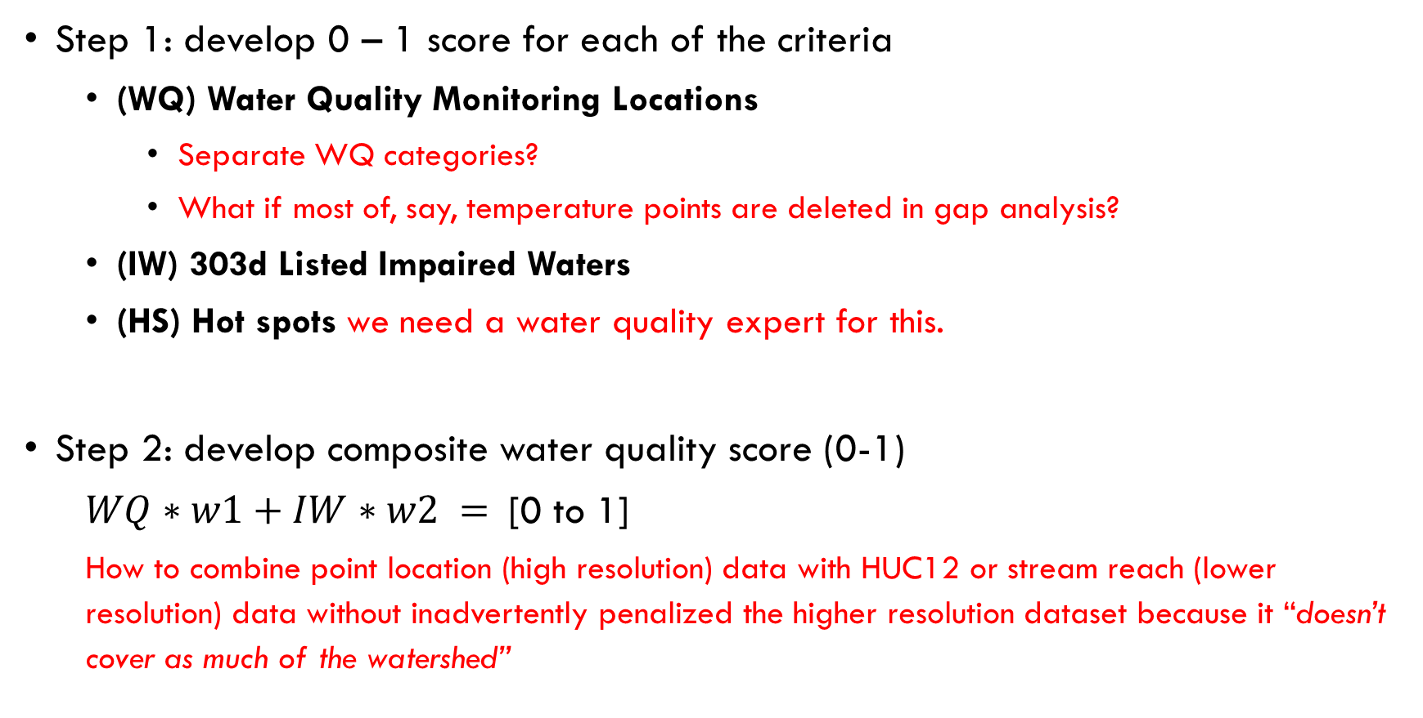
Water Quality Management (proposed) methodology
Step 1: develop 0 – 1 score for each of the criteria
(WQ) Water Quality Monitoring Locations
Separate WQ categories?
What if most of, say, temperature points are deleted in gap analysis?
(IW) 303d Listed Impaired Waters
(HS) Hot spots we need a water quality expert for this.
Step 2: develop composite water quality score (0-1)
$WQ∗w1+IW∗w2 =$[0 to 1]
How to combine point location (high resolution) data with HUC12 or stream reach (lower resolution) data without inadvertently penalized the higher resolution dataset because it “doesn’t cover as much of the watershed”

Slide 39
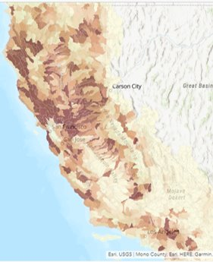
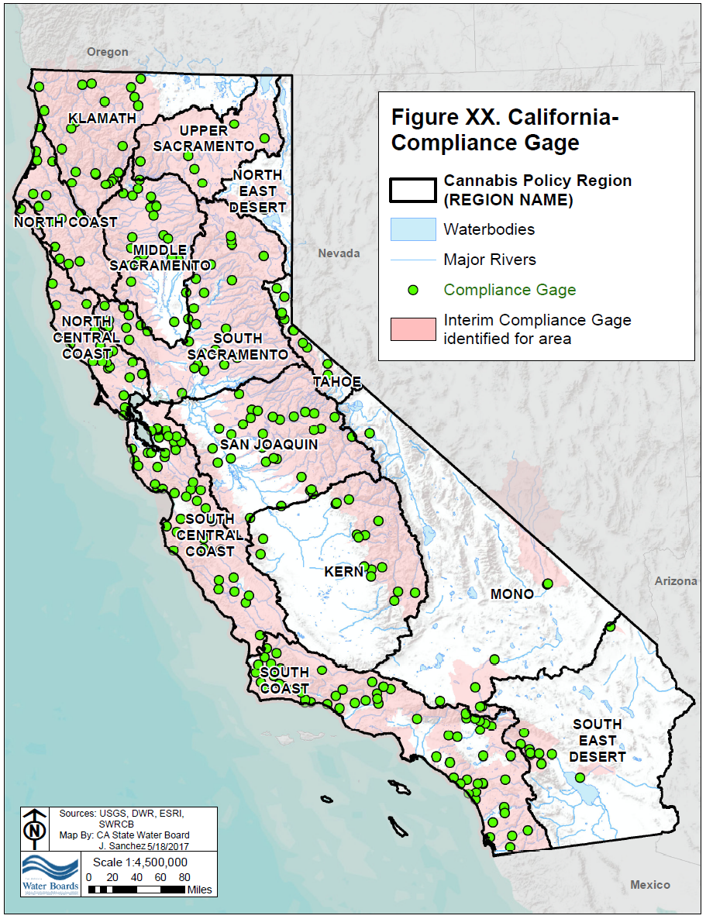
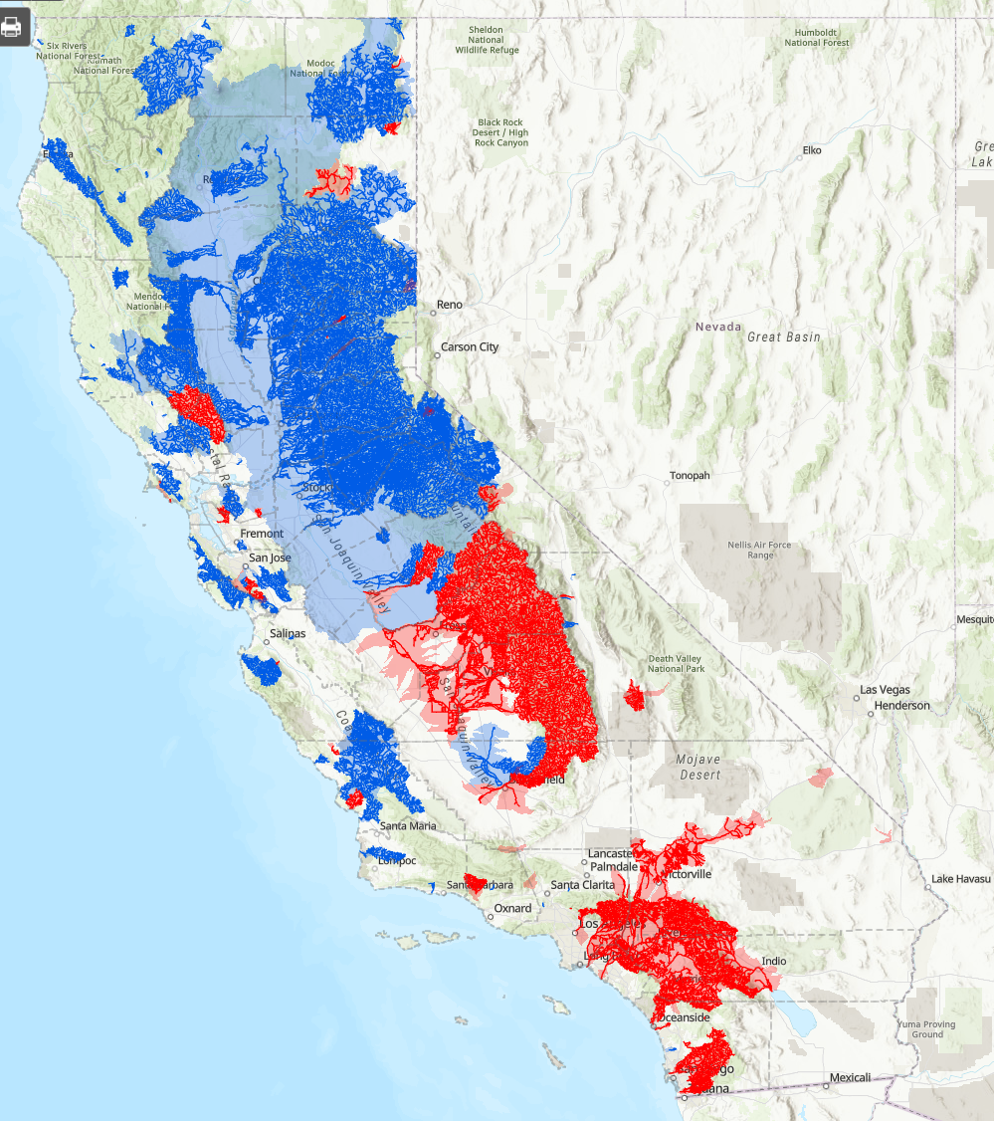
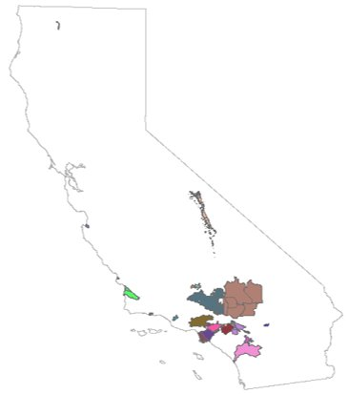
Water Supply Management Criteria
Preliminary Recommended Selection
Surface Water Diversions point location resolution -> density of points OR total volume per area
Cannabis cannabis tool gage gap (where does the tool not perform well – scored 0-1)
Fully Appropriated and Adjudicated Streams/Basins stream segment or basin resolution
Include in FloodMAR?
Bimodel: rank 0 or 1
Flood Managed Aquifer Recharge (FloodMAR) Suitability resolution unclear -> UCs upstream of most suitable location
SWRCB and DWR datasets
Notes:
Will use ECOSYSTEM

Slide 40
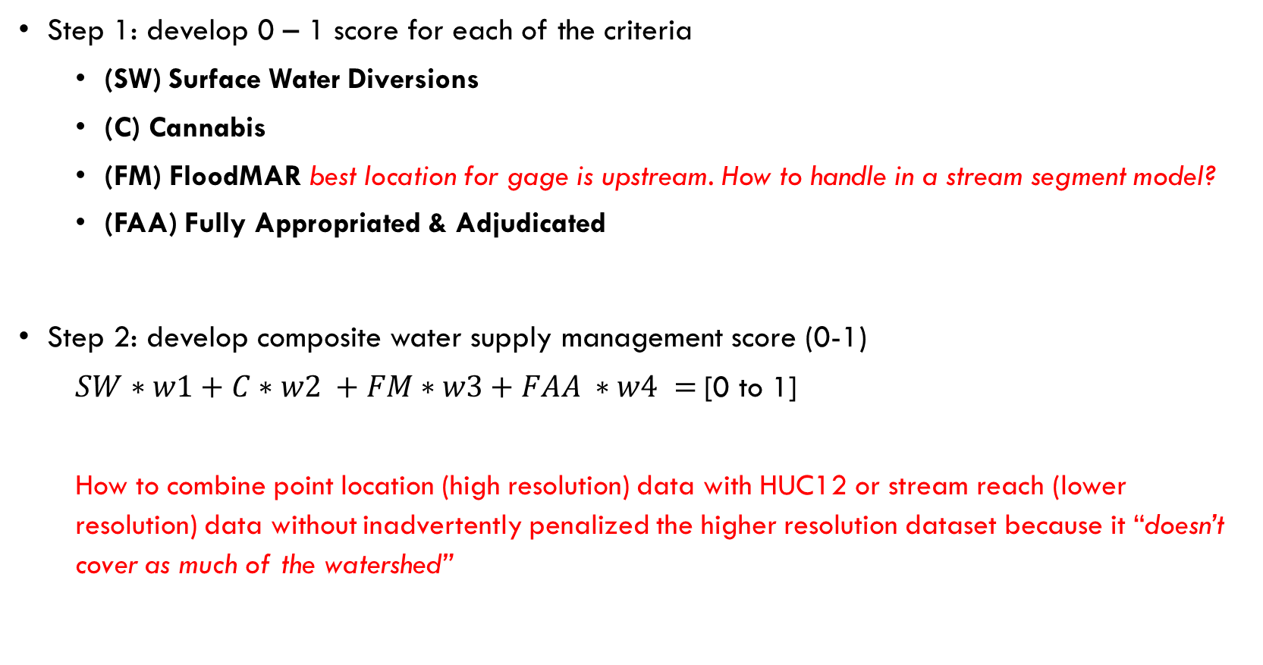
Water Supply Management (proposed) methodology
Step 1: develop 0 – 1 score for each of the criteria
(SW) Surface Water Diversions
(C) Cannabis
(FM) FloodMAR best location for gage is upstream. How to handle in a stream segment model?
(FAA) Fully Appropriated & Adjudicated
Step 2: develop composite water supply management score (0-1)
$SW∗w1+C∗w2 +FM∗w3+FAA ∗w4 =$[0 to 1]
How to combine point location (high resolution) data with HUC12 or stream reach (lower resolution) data without inadvertently penalized the higher resolution dataset because it “doesn’t cover as much of the watershed”
Notes:
iGDE – the easiest method is “does the stream segment cross a wetlands Y/N”. Does not consider

Slide 41
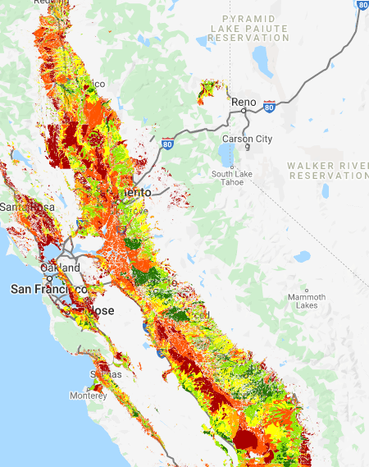
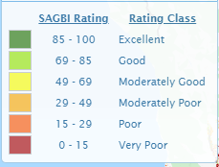
FloodMAR example Spatial and Temporal Challenges for Prioritization
Spatial: What if the best place for a gage is upstream of the data layer? Are all stream segments upstream equally valuable or not?
Temporal: Should we consider current land use or crop suitability for this process?
Legal: Should we include fully-appropriated streams (no water), allowing for future water transfers?
Flood hazard, debris flow (fire), water supply, and water quality all have spatial and temporal questions.
Soil Agriculture Groundwater Banking Index
https://casoilresource.lawr.ucdavis.edu/sagbi/
Notes:
Ask Normal and Todd if they have stuff to add

Slide 42
FloodMAR example Prioritization vs. Narrative Recommendations vs. Credit
Prioritization: FloodMAR priority gages should be located upstream of SAGBI Excellent or Good areas, rated from 0 to 1.
Narrative: Consider latest crop suitability layers and legal appropriation of water before finalizing gage location for the purpose of FloodMAR.
Giving Credit: any gage proposed upstream of a suitable potential FloodMAR location (>49), for any purpose, can be given credit for supporting FloodMAR, regardless of whether that location is a priority for FloodMAR.
Soil Agriculture Groundwater Banking Index
Notes:
Ask Normal and Todd if they have stuff to add
Crop Typing – Todd send link DWR atlas

Slide 43
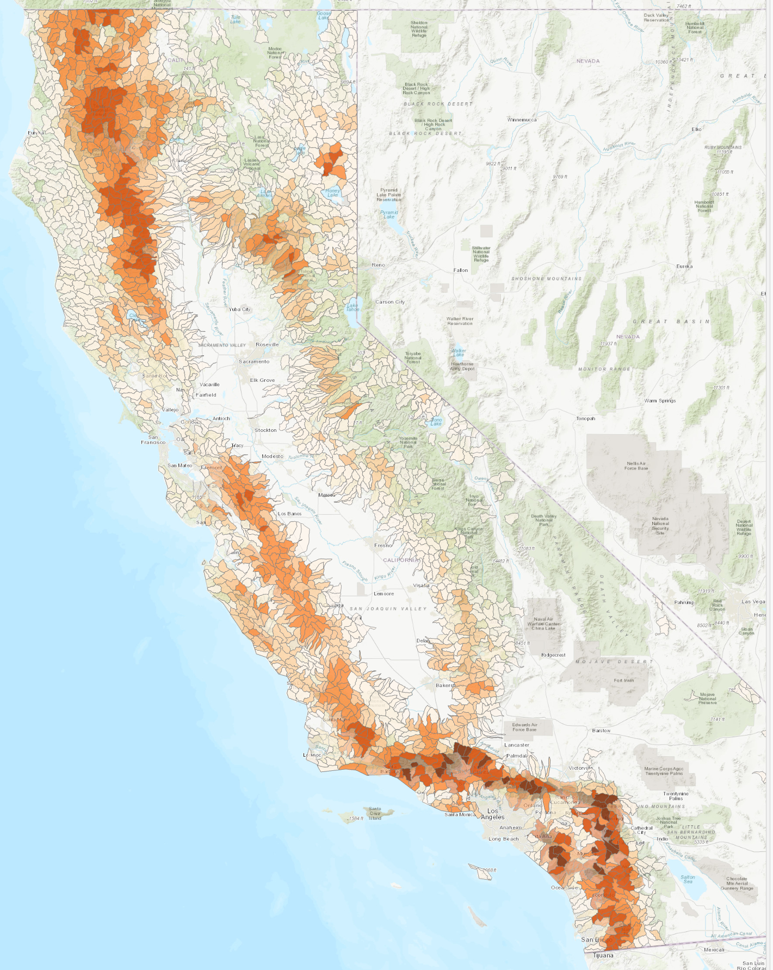
Flood Management Criteria
a data-driven approach to identify and prioritize data gaps regarding the application of stream gage data to manage risk to water resources, infrastructure, and the public due to forest fire, landslides, and amplified post-fire floods.
Preliminary Recommended Selection
Post-Fire Sedimentation Risk Map
Analysis developed by California Geological Survey (CGS) for the purpose of supporting SB19
Reference gages will help water supply managers and reservoir operators build better models to predict reservoir inflows, groundwater recharge, and summer baseflows.
CNRFC 1. Current Forecasting Point; 2. Inactive / old Forecasting Points; 3. Inflows to Reservoirs (FIRO projects); 4. where we want gages
Notes:
Stream gages, along with rain gages, close to or within burned watersheds are essential both to monitor and determine the runoff response necessary to forecast flood conditions. Because headwater basins are highly compartmentalized and because regression-based interpolations are often not valid options, the ability to predict and manage risk in the aftermath of forest fire, mortality, or intense timber management could be dramatically improved with more stream gages that could be either temporary or permanent, especially if coupled with meteorological sensors.
Although flood and debris flow risk may diminish as disturbed watersheds recover; to monitor and predict changes in ecosystem and water supply at landscape scales over decades, a dense network of permanent and temporary gages is needed to establish baseline relationships between precipitation and runoff and to monitor or predict hydrologic change (including real-time flood risk) due to changes in vegetation management, fire, or climate

Slide 44
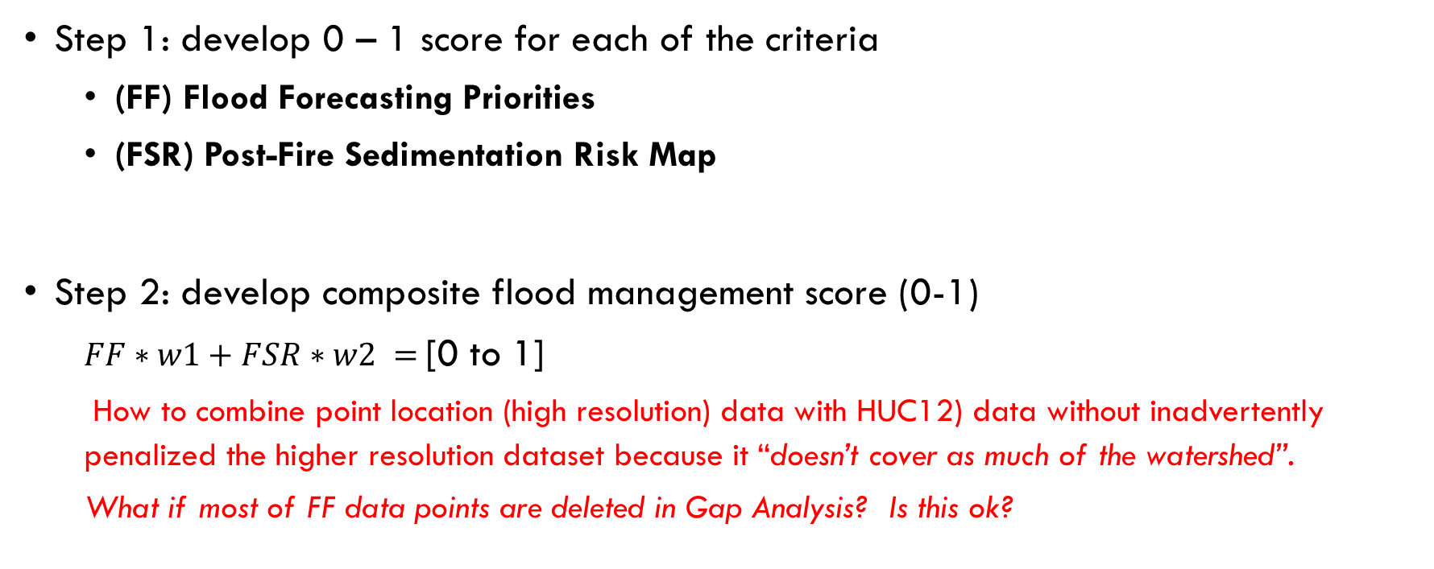
Flood Management (proposed) methodology
Step 1: develop 0 – 1 score for each of the criteria
(FF) Flood Forecasting Priorities
(FSR) Post-Fire Sedimentation Risk Map
Step 2: develop composite flood management score (0-1)
$FF∗w1+FSR∗w2 =$[0 to 1]
How to combine point location (high resolution) data with HUC12) data without inadvertently penalized the higher resolution dataset because it “doesn’t cover as much of the watershed”.
What if most of FF data points are deleted in Gap Analysis? Is this ok?
Reference gages have their own category but could be used to “give credit” for flood management

Slide 45
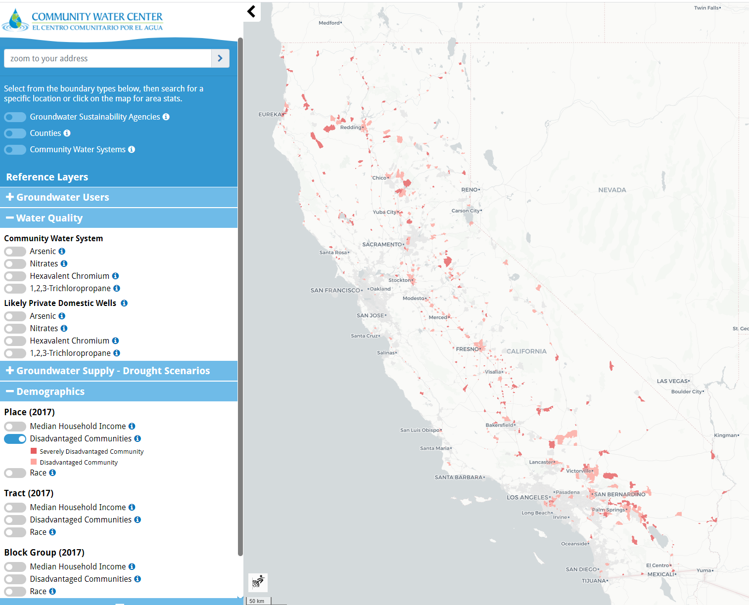
Additional Criteria Datasets – No idea how to add this!
Drinking Water
and Disadvantaged
Communities
Climate Vulnerability
Tribal Lands? What are priorities for the tribes (is there a dataset? Narrative description?)
Community Water Center (2020), Drinking Water Tool US EPA (2013), California Integrated Assessment of Watershed Health

Slide 46
Multi-Criteria Decision Analysis (example methodology)
Criteria wm
Criteria wm-overall wm-internal*
Biodiversity 0.1 50%
Priority Conservation Network 0.05 25%
iGroundwater Dependent Ecosystem 0.05 25%
Reference Composite 0.2 100%
WQ – most visited sites 0.1 50%
303d listed sites 0.1 50%
Surface Water Diversion 0.1 50%
Cannabis 0.05 25%
FloodMAR 0.1 25%/25%
Fire and Landslide 0.15 75%
Ecosystem 0.2
Reference 0.2
Water Quality 0.2
Water Supply 0.2
Flood 0.2
*wm-internal is displayed as % to highlight relative importance
MDCA score (0-1)
M = the # criteria, m = each individual criteria, wm is the weight for each
Notes:
The weight equation allows throwing everything into a single analysis. Could consider each of the 4 priorities separately OR mash everything up. Mashing is more complex due to large # of parameters. Be wary of double-counting (e.g. FloodMAR is in Flood or Water Supply, but not both, unless downweighted), and correlations.

Slide 47
Weighting Considerations
Overall value to stakeholders
Correlation. This can be a positive (multi-benefit) or a negative (excludes something important).
Co-dependence.
Desire (or not) to distribute new gages fairly or evenly between categories?
Current distribution of gages to meet the criteria (e.g. are gages serving one criteria well and other criteria poorly?)
Equal weighting (w1 = w2 = w3) is a value-judgement by itself.
Notes:
Is “Managing for Multiple Benefits” inherently at odds with “Ecosystem” Priorities?
Should we “bin” the ranking – e.g. reserve high priority slots for each of the criteria in addition to combined rankings? (Composite AND Individual Priorities

Slide 48
Multi-Criteria Decision Analysis (example methodology)
Criteria Category wm
Criteria wm-overall wm-internal
Biodiversity 0.1 50%
Priority Conservation Network 0.05 25%
iGroundwater Dependent Ecosystem 0.05 25%
Reference Composite 0.2 100%
WQ – most visited sites 0.1 50%
303d listed sites 0.1 50%
Surface Water Diversion 0.1 50%
Cannabis 0.05 25%
FloodMAR 0.1 25%/25%
Fire and Landslide 0.15 75%
Ecosystem 0.2
Reference 0.2
Water Quality 0.2
Water Supply 0.2
Flood 0.2
*wm-internal is displayed as % to highlight relative importance
THIS ANALYSIS IS FOR INTERNAL REVIEW ONLY!
Multi-criteria is part of the bill. However, we do not want to a) pit management criteria against each other and b) do not want to box ourselves into a potentially meaningless #, with high sensitivity to weighting, nor prioritize mediocre sites at the expense of high value sites.
Notes:
WE should distribute criteria, weights, and a preliminary analysis to the TAC. This is not a complete list of criteria.
Is mashing it up even appropriate for a public document? Danger of boxing in to single metric.

Slide 49
Stream Segment Selection Concerns
Perennial vs Intermittent vs. Ephemeral (do we ignore ephemeral streams?) we do not have enough data to support this in NHDPlus v2, but we may be able to apply criteria from eFlows and require selecting higher order streams, or add a narrative recommendation.
Stream order or Drainage Area (NHDPlus v2 VAA) threshold to ignore?
Other suitability criteria do we eliminate non-natural sites? note – the data may not support this as some major rivers have been moved and are thus coded as artificial.
Multi-benefits may be a function of resolution: e.g. there may be multiple needs within a HUC12, but it may be impossible to select a site to cover all benefits if they occur in different parts of the watershed.
Scale: stream segment vs. HUC – how to change scale for purposes of a high-level report? For identifying priorities?
Notes:
Is “Managing for Multiple Benefits” inherently at odds with “Ecosystem” Priorities?
Are some of the input criteria correlated, and if so, should we change the relative weighting?
Are ephemeral streams in the scope of a stream gaging plan if that are dry and flashy, or is that a different monitoring effort?

Slide 50
Prioritization and Ranking Summary
Each of the management criteria have unique challenges
Ecosystem = most straightforward; main challenge is scale and spatial distribution of criteria
Reference gage = “backwards” analysis – look for gaps first, then test for suitability
Combining high resolution or point data with lower resolution or HUC data may result in penalizing the high-resolution data if “averages” are used for an analysis.
Bringing the different analyses into a single ranking for the entire state will require considerations of correlation and weighting. Transparency is important.
Considering each category separately at the HUC12 level may result in too many undifferentiated priorities – scaling method is important for both the legislative report and the prioritization
Legislative report: high level, low resolution (mostly simplifies the problem).
Data visualization and decision tool: higher resolution, dynamic analysis, potential to outlive project

Slide 51
References (incomplete list)
Grantham, T. and Andrews, L. (2020), Efficiently Expanding California’s Gaged Stream Network, White paper (personal communication).
Grantham, T. and Andrews, L. (2020), Stream Network Analysis for Gages, UC Berkeley presentation 22 October.
The Nature Conservancy Gage Gap II (2019), www.codefornature.org
Falcone, J.A., 2017, U.S. Geological Survey GAGES-II time series data from consistent sources of land use, water use, agriculture, timber activities, dam removals, and other historical anthropogenic influences: U.S. Geological Survey data release, https://doi.org/10.5066/F7HQ3XS4.
Lane, B.A., Sandoval-Solis, S., Stein, E.D. et al. (2018). Beyond Metrics? The Role of Hydrologic Baseline Archetypes in Environmental Water Management. Environmental Management 62, 678–693. https://link.springer.com/article/10.1007/s00267-018-1077-7
Zimmerman, JKH, Carlisle, DM, May, JT, et al. (2018). Patterns and magnitude of flow alteration in California, USA. Freshwater Biol. 63: 859– 873. https://onlinelibrary.wiley.com/doi/full/10.1111/fwb.13058
California e-flows data page: https://eflows.ucdavis.edu/hydrology
US EPA (2013), California Integrated Assessment of Watershed Health, https://mywaterquality.ca.gov/monitoring_council/healthy_watersheds/assessment.html
California Water Indicators Portal https://indicators.ucdavis.edu/cwip/
O'Geen A, Saal M, Dahlke H, Doll D, Elkins R, Fulton A, Fogg G, Harter T, Hopmans J, Ingels C, Niederholzer F, Sandoval Solis S, Verdegaal P, Walkinshaw M. 2015. Soil suitability index identifies potential areas for groundwater banking on agricultural lands. Calif Agr 69(2):75-84. https://doi.org/10.3733/ca.v069n02p75.
SAGBI Data Portal https://casoilresource.lawr.ucdavis.edu/sagbi/
Community Water Center Drinking Water Tool https://drinkingwatertool.communitywatercenter.org/data/
Notes:
This is an incomplete list

